Slide 1

IBM DATA SCIENCE CAPSTONE PROJECT
- Khushi Thakkar

Slide 2
INTRODUCTION
Aim: To analyse the accident “severity” in terms of human fatality, traffic delay, property damage, or any other type of accident bad impact.
Data: Collected by Seattle SPOT Traffic Management Division and provided by Coursera via a link. This dataset is updated weekly and is from 2004 to present. It contains information such as severity code, address type, location, collision type, weather, road condition, speeding, among others.
Target audiences: People who really care about the traffic records, especially in the transportation department. Also, we want to figure out the reason for collisions and help to reduce accidents in the future.

Slide 3
DATA
194,673 observations and 38 variables in this data set.
Since we would like to identify the factors that cause the accident and the level of severity, we will use SEVERITYCODE as our dependent variable Y, and try different combinations of independent variables X to get the result.
Since the observations are quite large, we may need to filter out the missing value and delete the unrelated columns first. Then we can select the factor which may have more impact on the accidents, such as address type, weather, road condition, and light condition. The target Data to be predicted under (SEVERITYCODE 1-prop damage 2-injury) label.
Other important variables include:
ADDRTYPE, LOCATION, PERSONCOUNT, VEHCOUNT, JUNCTIONTYPE, WEATHER, ROADCOND, LIGHTCOND, SPEEDING, SEGLANEKEY, ETC.

Slide 4
METHODOLOGY
We used Jupyter Notebook to do the data analysis. To generate the table and graph for the dataset, we imported Python libraries (Pandas, Numpy, Matplotlib, and Seaborn).
First, we imported the data through pd.read_csv. We noticed that it had 194,673 rows and 38 columns. Therefore, we narrowed it down to 8 columns (‘Severity’, ‘X’, ‘Y’, ‘Location’, 'Vehcount’, ‘Weather’, ‘Roadcond’, ‘Lighdcond’) and delete the missing values, which made the final dataset with 184,167 observations and 8 variables.
We have to select the most important features to weigh the severity of accidents in Seattle. Among all the features, the following features have the most influence in the accuracy of the predictions - The ‘WEATHER’, ‘ROADCOND’ and ‘LIGHTCOND’ attributes.

Slide 5
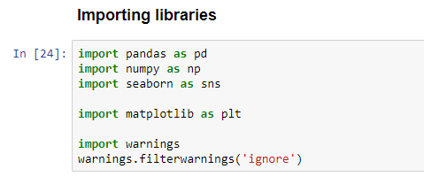
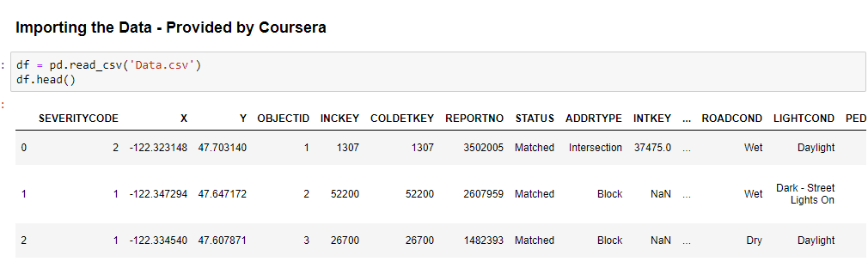
METHODOLOGY
IMPORTING LIBRARIES AND DATA

Slide 6
METHODOLOGY - EDA
The dataset in the original form is not ready for data analysis. In order to prepare the data, first, we need to drop the non-relevant columns. In addition, most of the features are of object data types that need to be converted into numerical data types. After analysing the data set, I have decided to focus on only four features, severity, weather conditions, road conditions, and light conditions, among others.
To get a good understanding of the dataset, I have checked different values in the features. The results show, the target feature is imbalance, so we use a simple statistical technique to balance it.

Slide 7
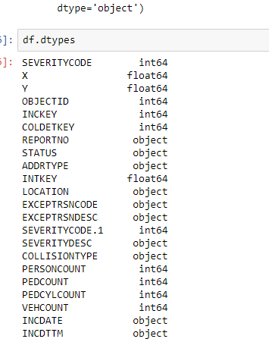
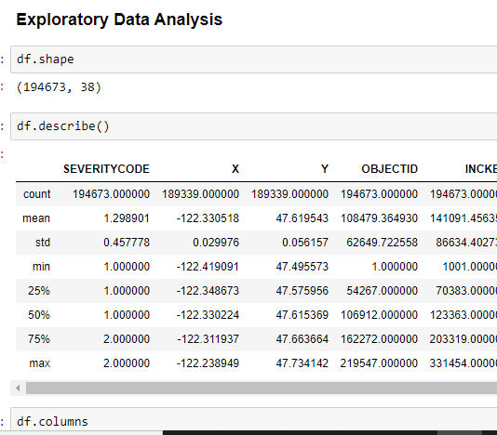
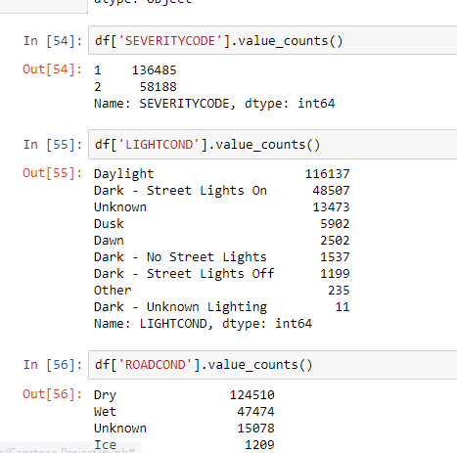
METHODOLOGY - EDA

Slide 8
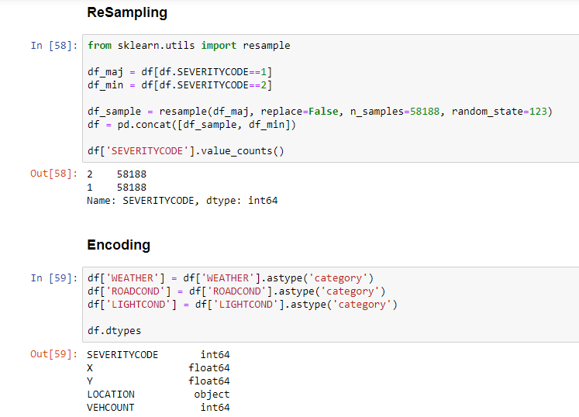
METHODOLOGY - RESAMPLING

Slide 9
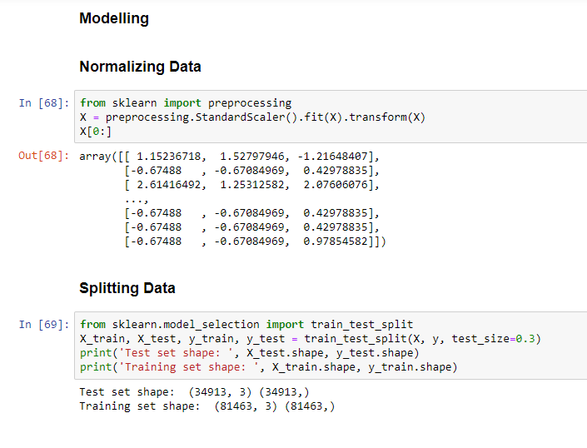
METHODOLOGY - MODELLING

Slide 10
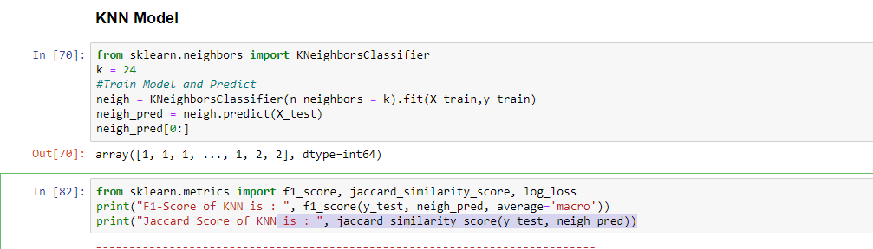
METHODOLOGY - KNN

Slide 11
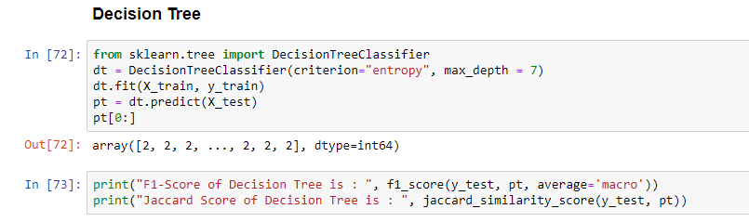
METHODOLOGY – DECISION TREE

Slide 12
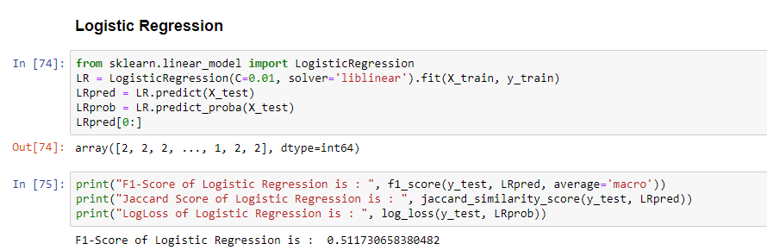
METHODOLOGY – LOGISTIC REGRESSION

Slide 13
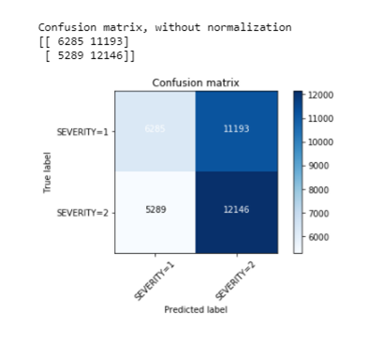
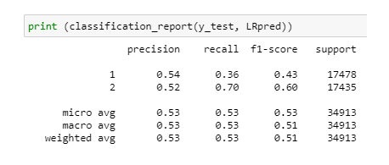
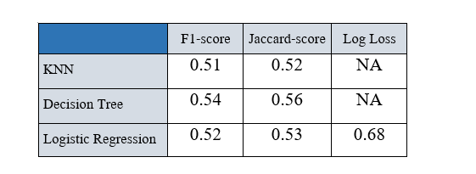
EVALUATION

Slide 14
OBSERVATIONS
At the beginning of this, we had a dataset that had a lot of features of type object, we did convert the columns into category type, then we encoded the labels to contain numerical values.
Once we converted our data to the proper type that can be fed to our models, we faced the problem of unbalanced dataset, we fixed this issue through resampling the dataset.
Due to the binary aspect of the ‘SEVERITYCODE’ attribute we want to predict(only classes 1 & 2 were in this dataset), a Logistic Regression model was the first intuitive solution, but we also built the K-Nearest Neighbors and Decision Tree models to have more results, contrary to what we expected, the Decision Tree model had better F1-score and Jaccard-score.
We can still improve the above models, by better tuning of the hyper-parameters like the “k” in KNN, the “max_depth” in the Decision Tree, and the “C” parameter in the Logistic Regression.

Slide 15
CONCLUSION
Based on historical data from the collision in Seattle, we can conclude that particular weather, road and light conditions have an impact on whether or not the car ride could result in one of the two classes property damage (class 1) or injury (class 2).

